Slide 1
Edutyping
Cyber Citizenship

Slide 2
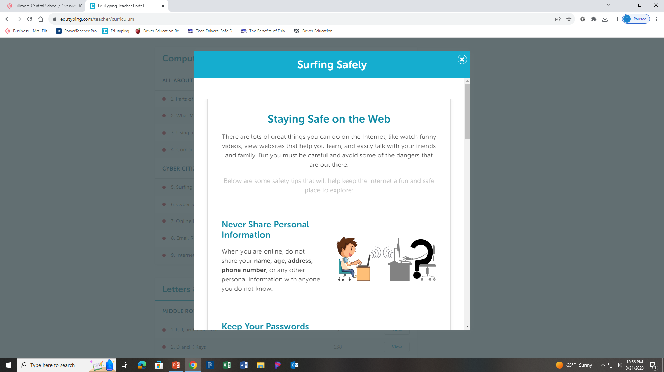
Surfing Safely

Slide 4
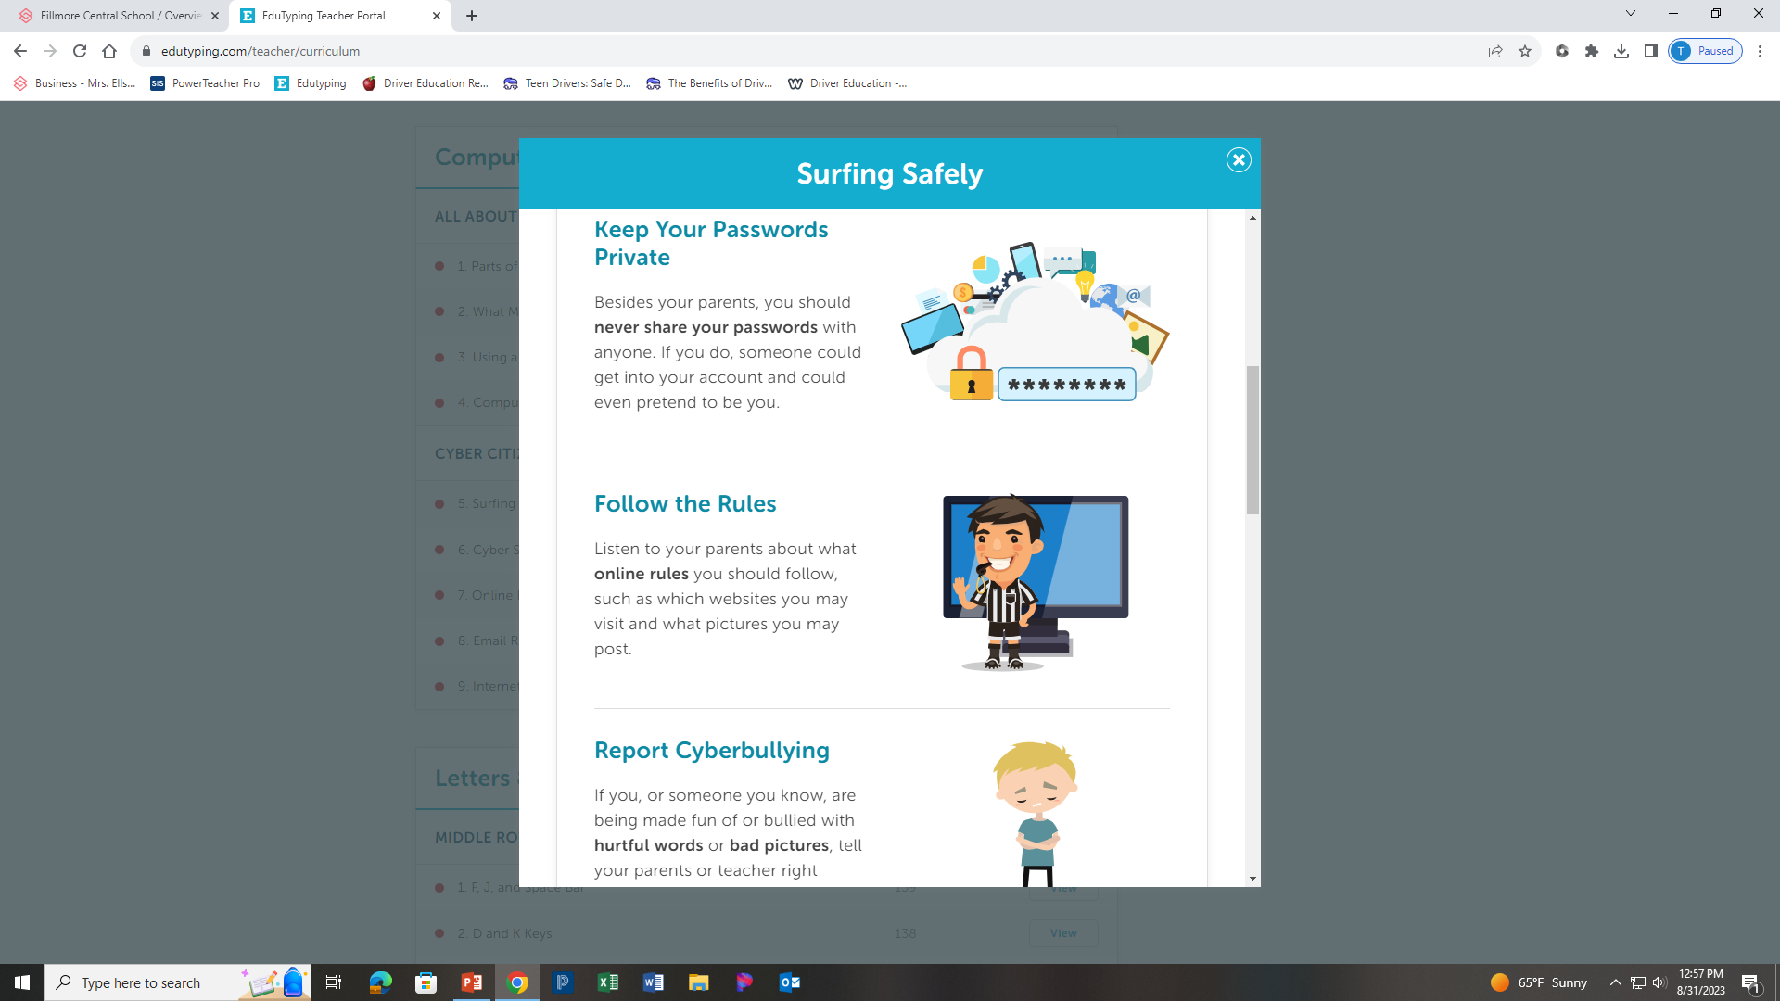

Slide 6
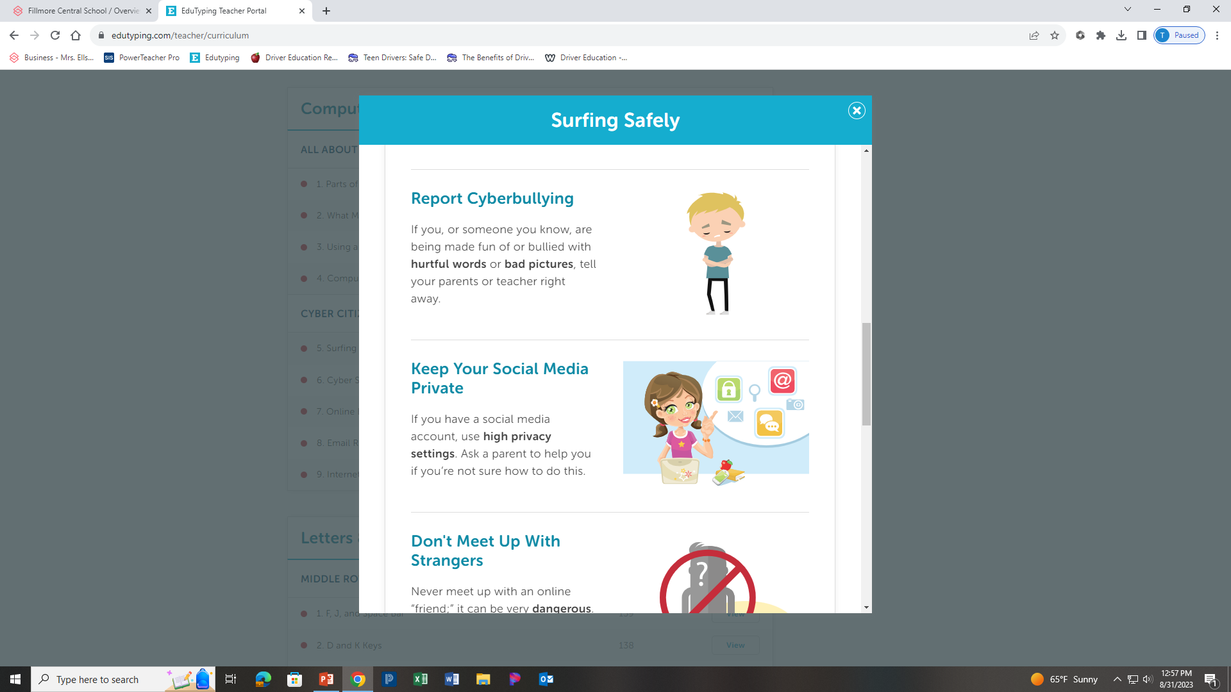

Slide 8
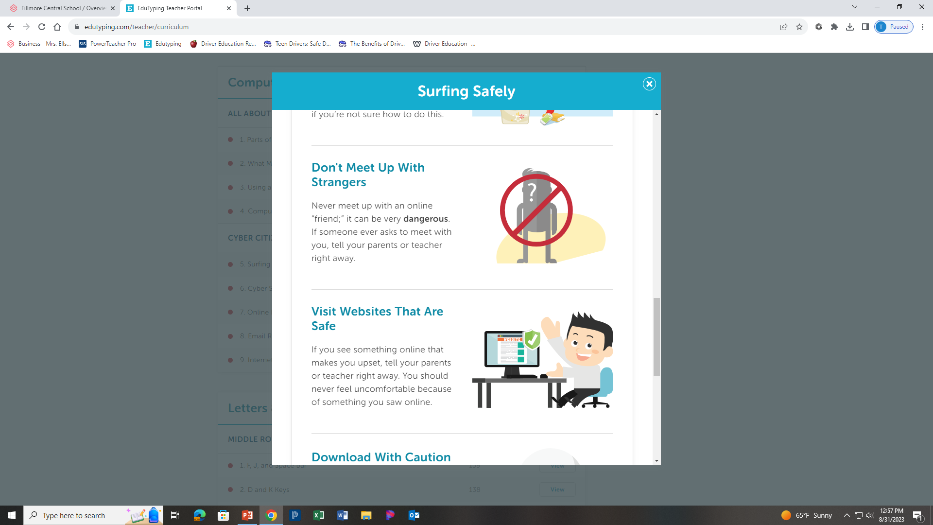

Slide 10
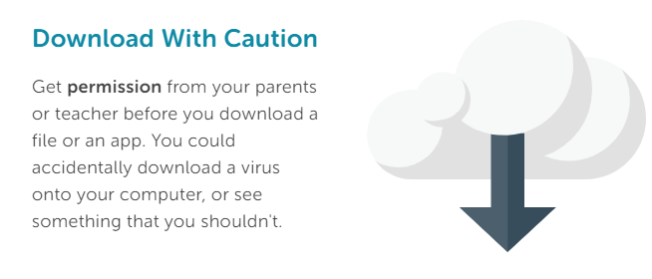

Slide 11
Complete Surfing Safely Review Packet

Slide 12
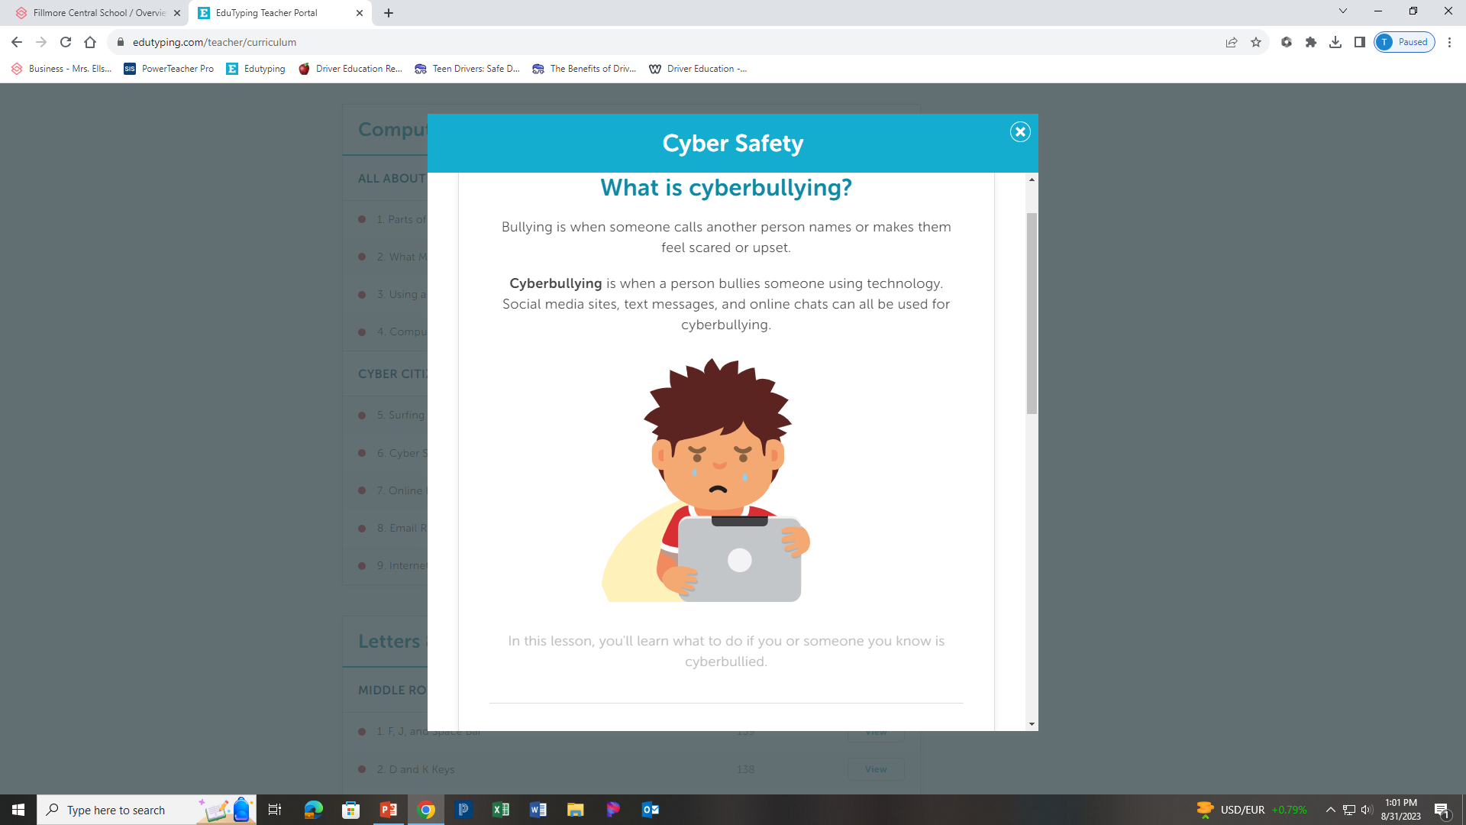
Cyber Safety

Slide 14
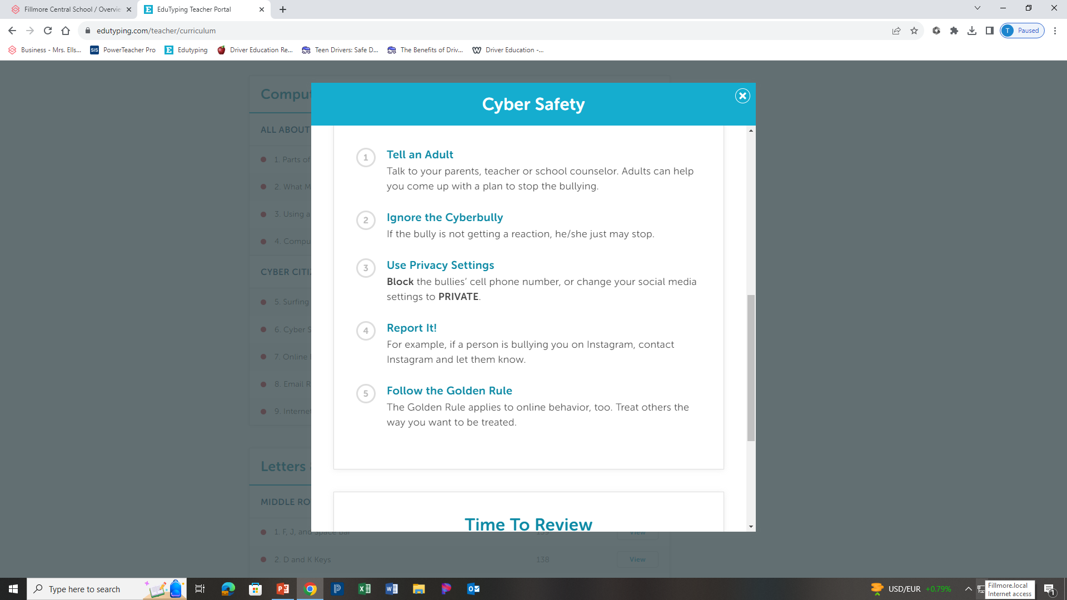

Slide 15
Complete Cyber Safety Review Packet

Slide 16
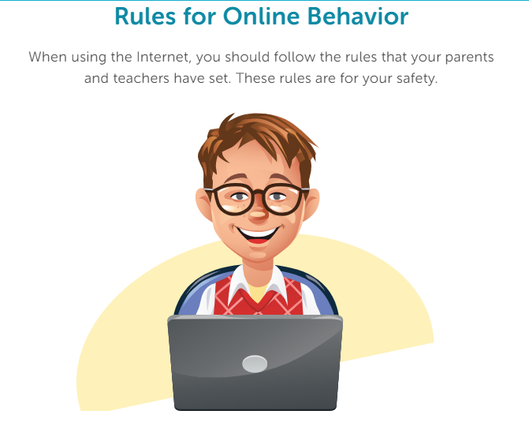
Online Behavior

Slide 17
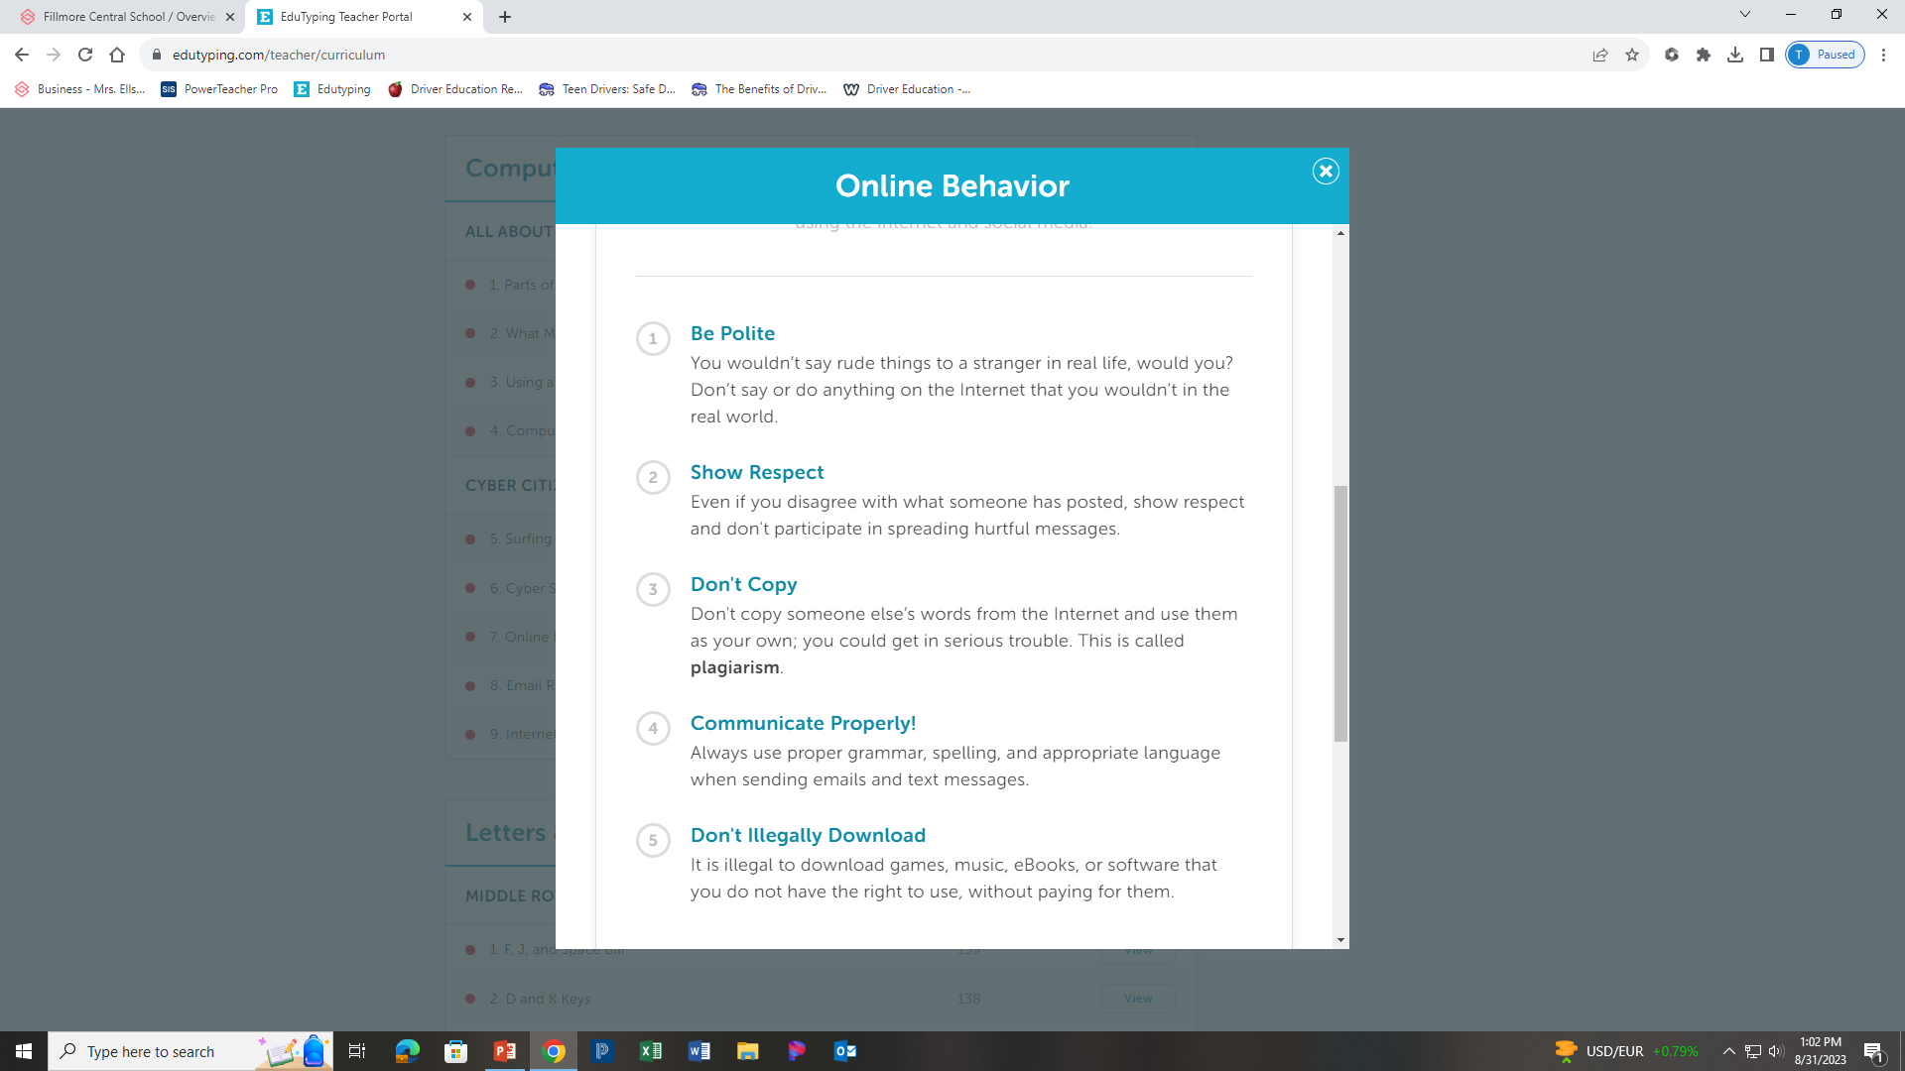

Slide 18
Complete Online Behavior Review Packet

Slide 19
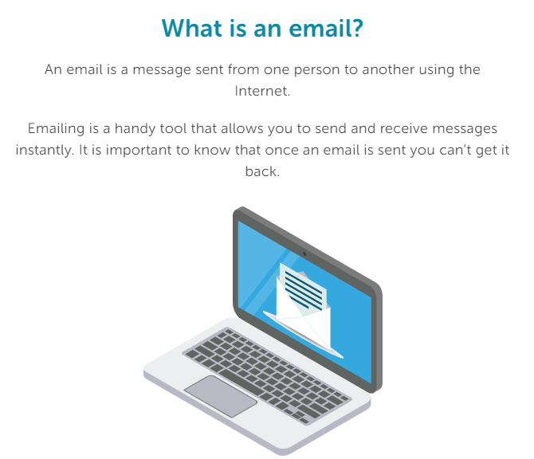
Email Rules & Manners

Slide 20
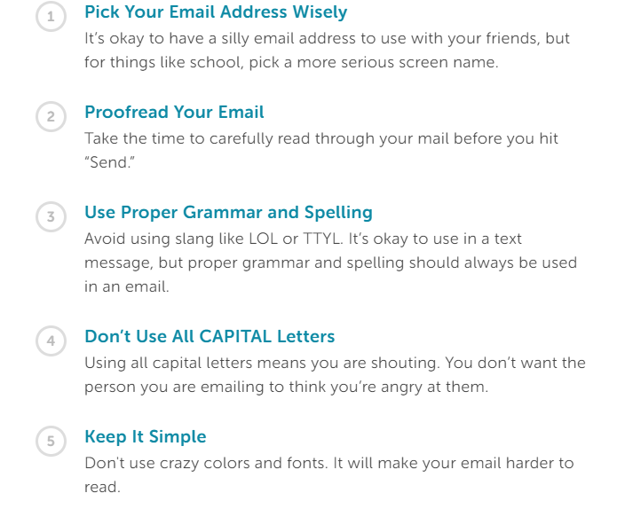
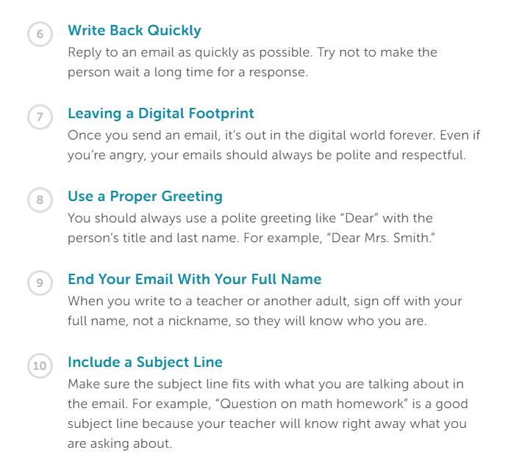

Slide 21
Complete Email Rules and Manners Review Packet

Slide 22
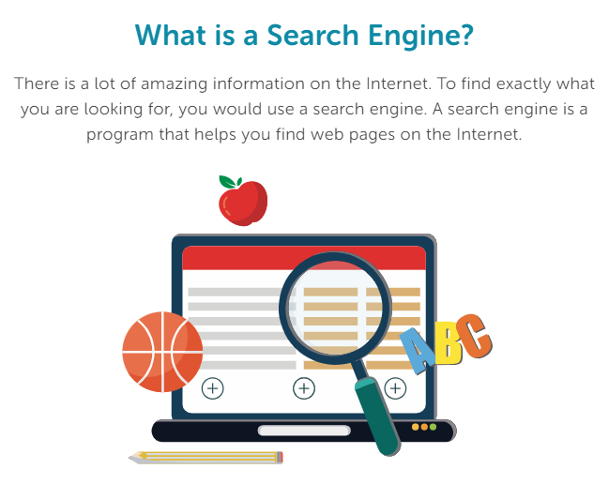
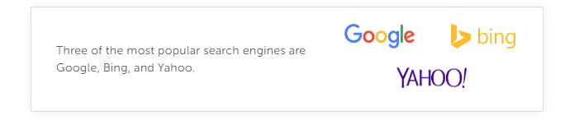
Internet Search Tips

Slide 23
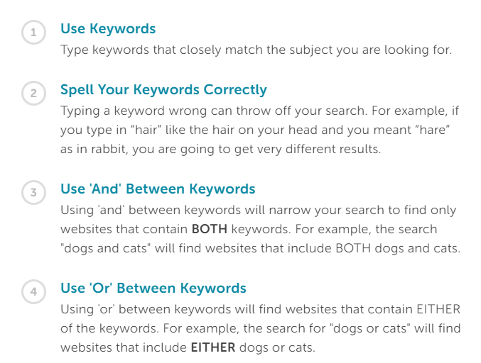
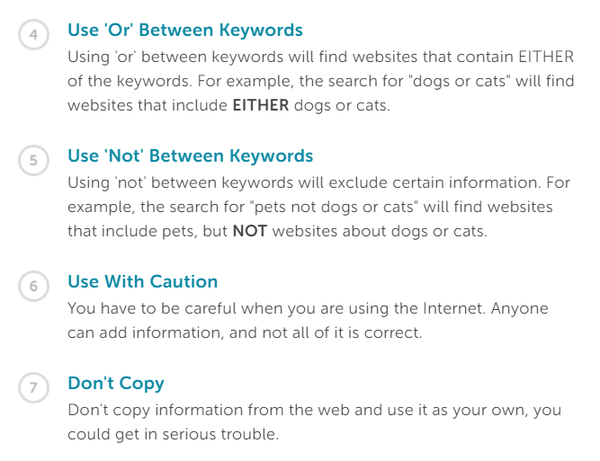
Tips and Tricks for Searching

Slide 24
Complete Online Behavior Review Packet

